Slide 1


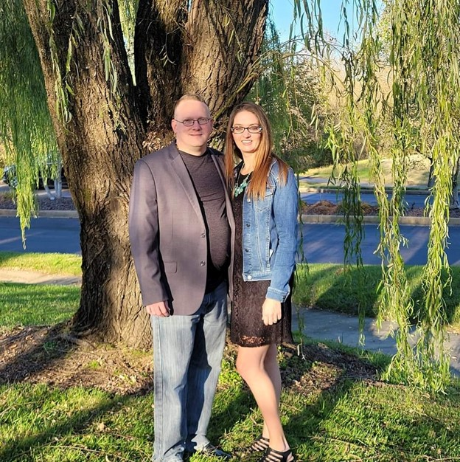

The Power of Housing and Security
can change a life
Dean’s House Foundation
(501C3)
KYARR Level II / Type M Recovery Homes
EIN 88-1530838
Joseph 270-872-7750
Stephanie 270-872-7511
www.deanshousefoundation.org
Info@deanshousefoundation.org
Contact us!
Dean’s House Foundation
1811 N Dixie Ave Ste 104
Elizabethtown, KY 42701
Founded in 2023
We are founders and owners of single family homes in safe, suburban neighborhoods.
We provide exceptional housing in great neighborhoods for veterans, drug court, mental health court and men and women recovering from substance use.
We offer support, tranquility, beauty, empowerment, safety and respect. We are partnered with multiple agencies and can
support medically assisted treatments for substance use disorder.

Slide 2
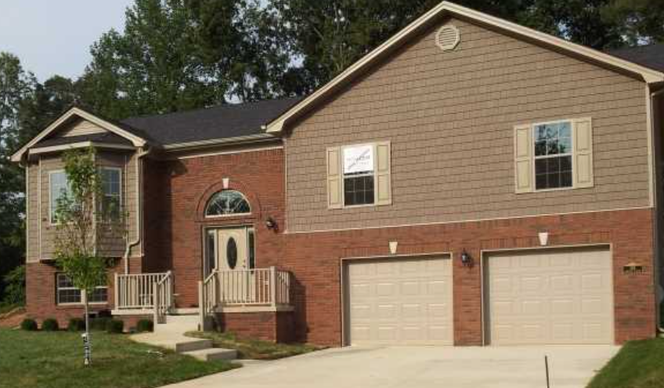
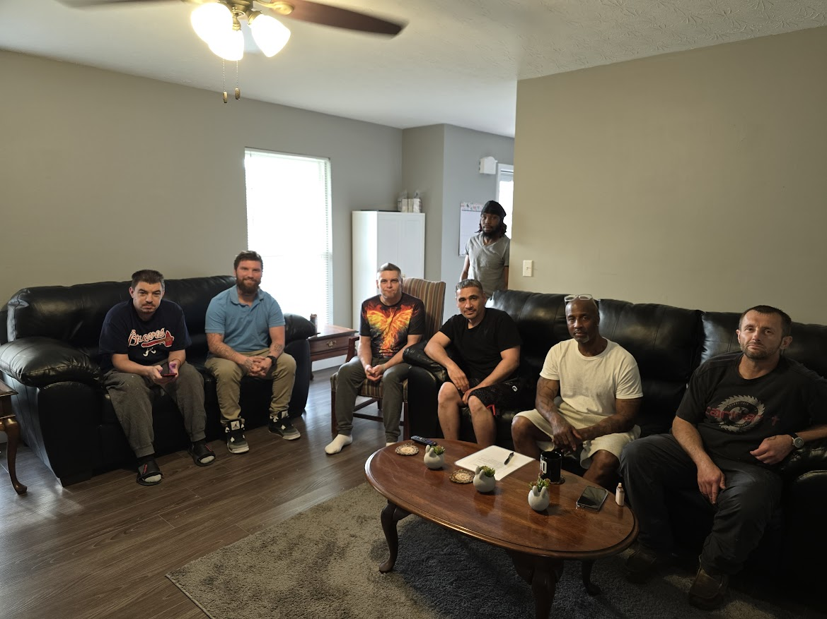
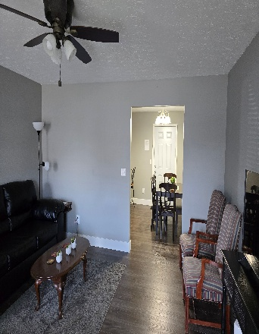
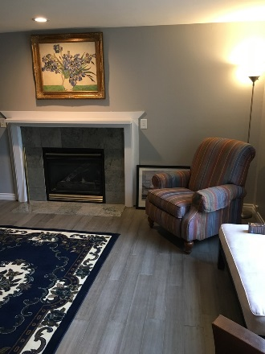
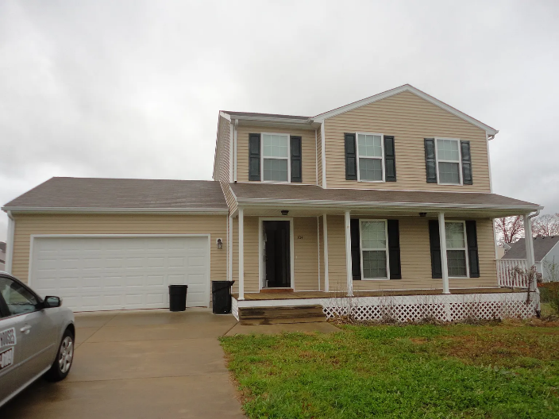
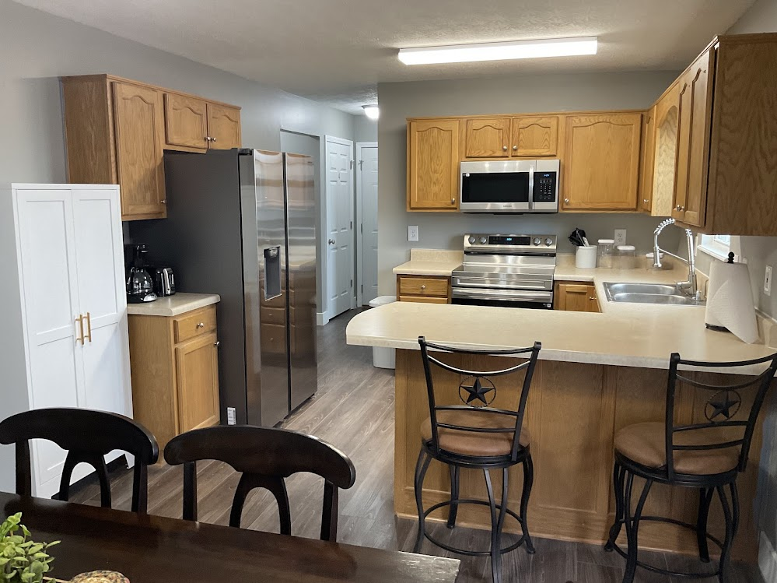
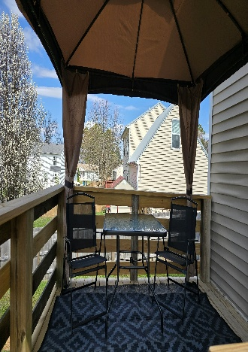
OUR PHILOSOPHY
We start with beautiful, shared housing with homes that are safe, secure and induce pride. Along with housing, we bring compassion and a large commitment from the community and we have many successful outcomes.
Our houses are strategically located near services that lead to successful recovery, education and employment.
Key clients
Department of Corrections
Department of Veterans Affairs
Drug Court
Federal Government
Mental Health Court
We provide homes and programs that exceeds national standards for people in recovery. With agency partnerships, a commitment to compassion, Dean’s houses provide the ideal home for healing.
We believe in the power of housing to help people achieve their greatest purpose.

